Slide 1
Manual Software Testing Full contents
Topics Cover
What is software Testing?
Type of Application
Software Testing (SDLC, Principles of STLC)
positive testing and negative testing.
Effective test cases and not-so-effective test cases
Environmental-related information
War room, hotfix, sprint, agile development.
Calculator-related scenario discussion.
Test case
Bug Reporting
UI testing checklist
WebSite test checklist
Test Case idea generation (Transfer Money)
Four Principles of QA Life
Test Metrics
Mind Maps
Software Test Life Cycle And Bug Life Cycle
Test Plan
Priority and severity discussion
Discuss scenario based question for manual tests
Test Technique (bva, ecp….)
Some Useful Concepts
Mistakes we do
Interview Questions set

Slide 2
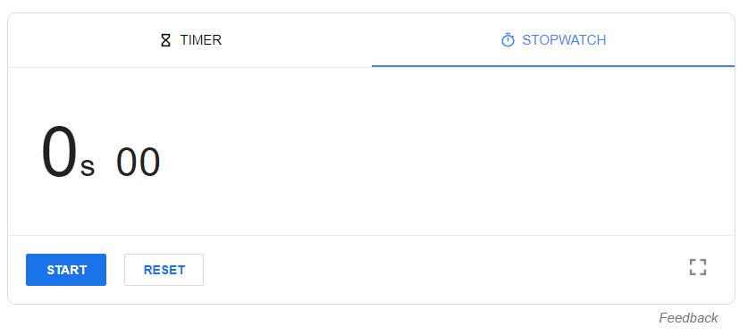
StopWatch testing

Slide 3
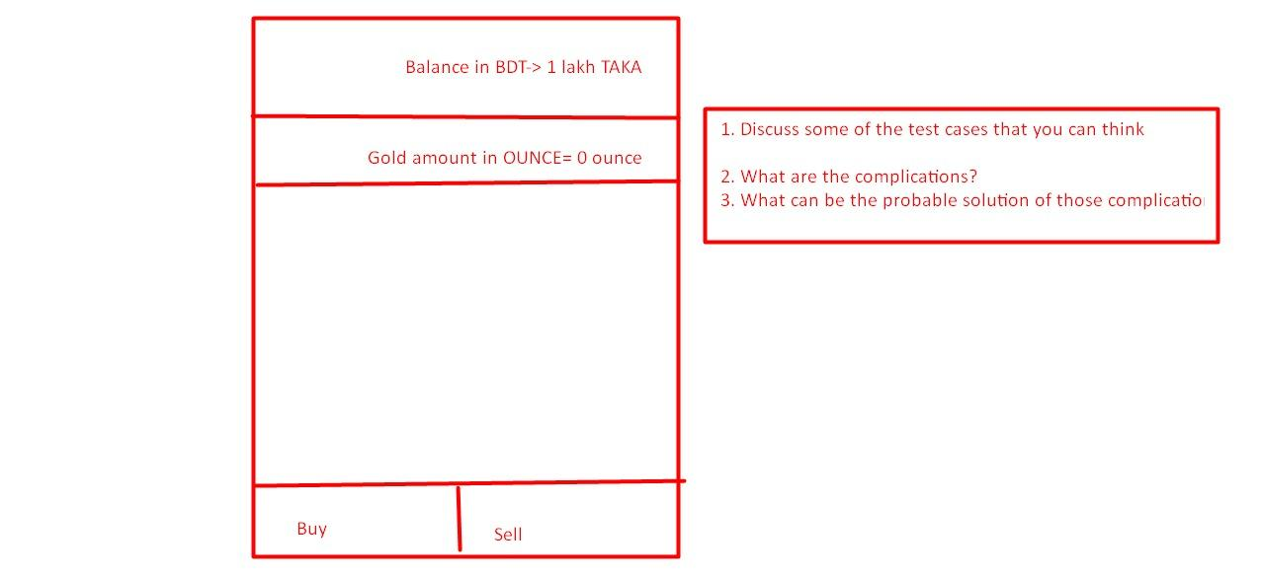
Manual Software Testing Tasks

Slide 4
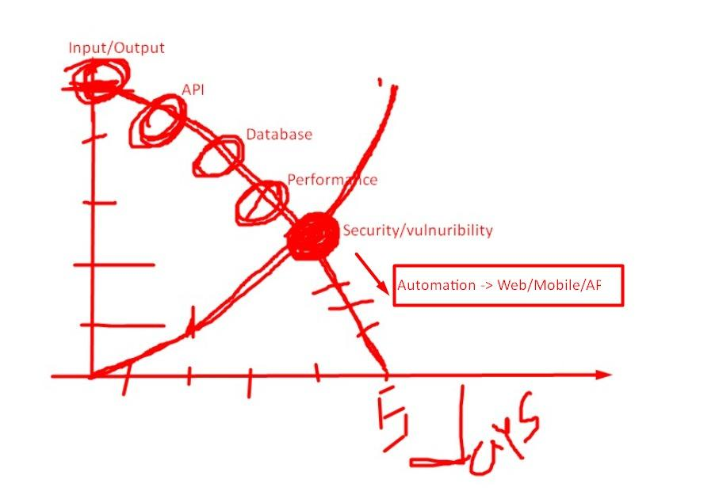
Manual Software Testing Tasks

Slide 5
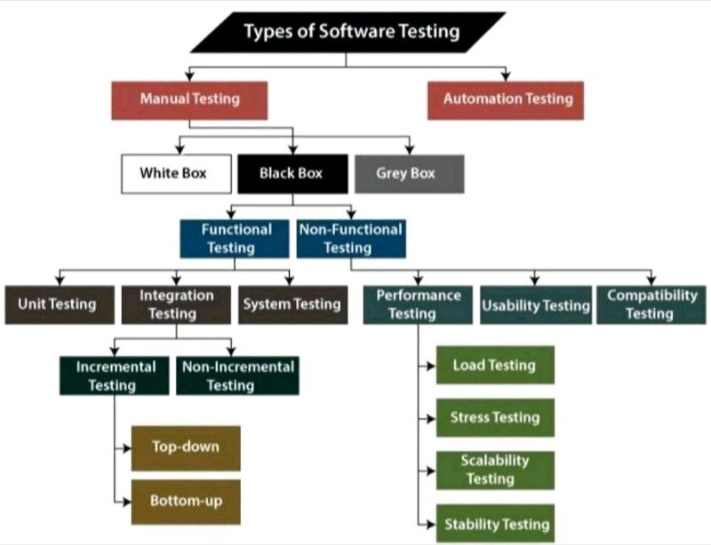
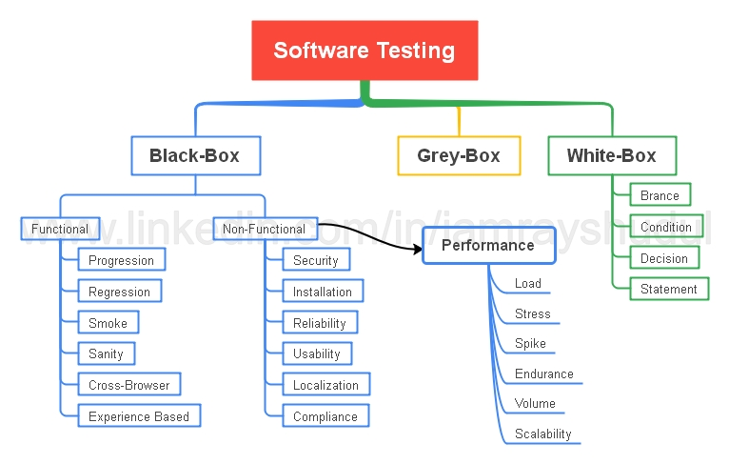
Type of Testing

Slide 6
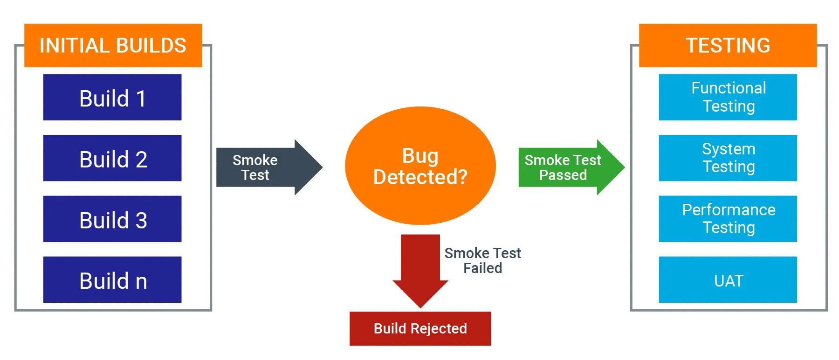
When to do Performance Testing

Slide 7
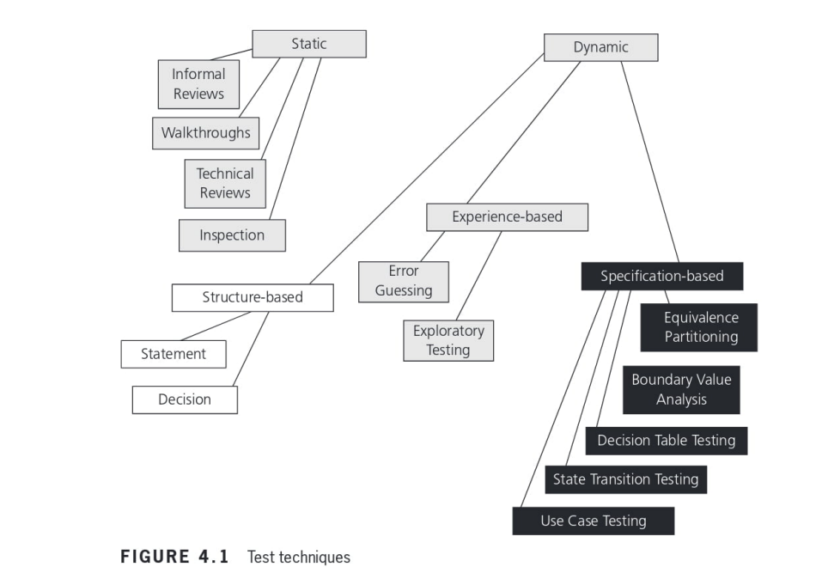

Slide 8
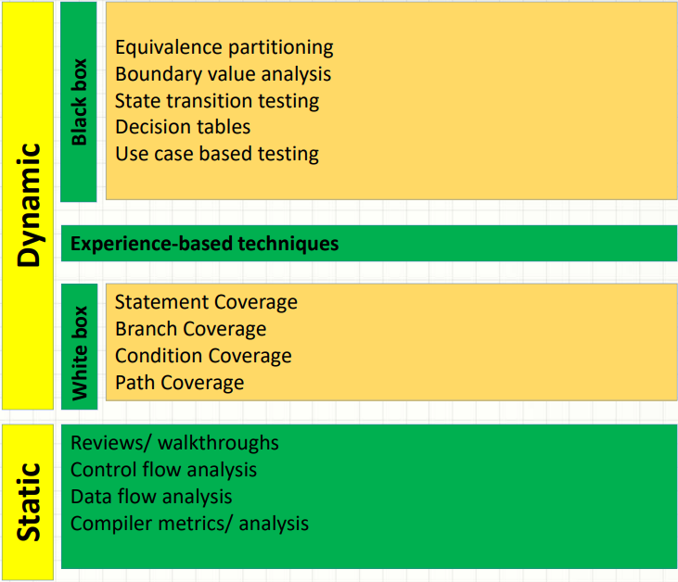

Slide 9
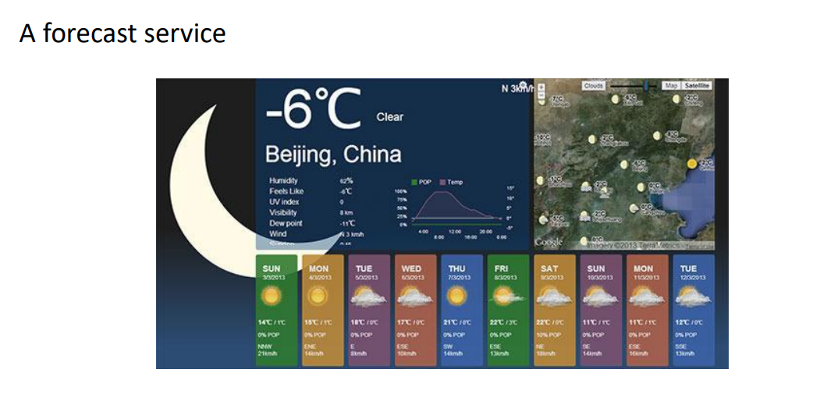
Type of Application

Slide 10
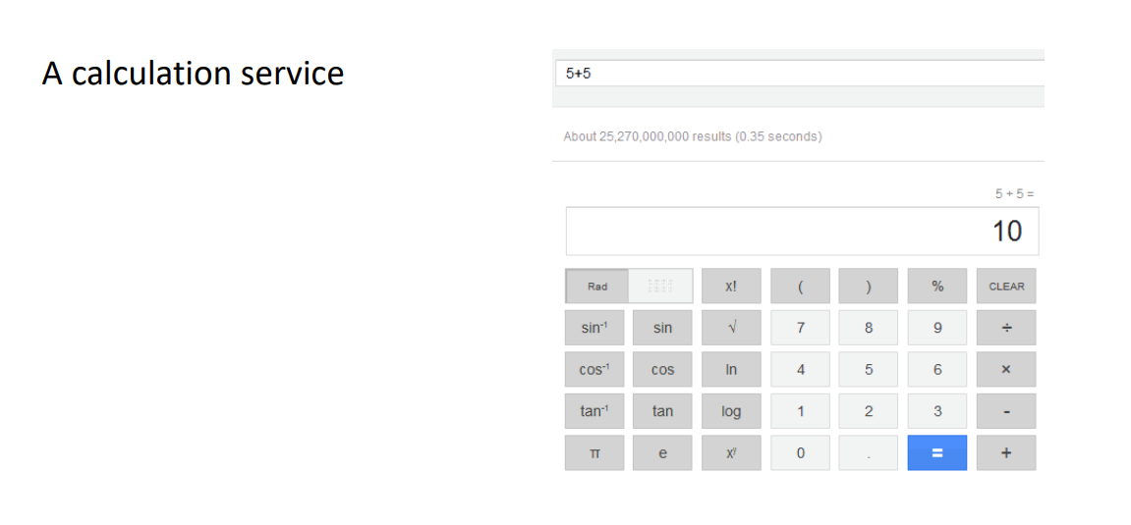
Type of Application

Slide 11
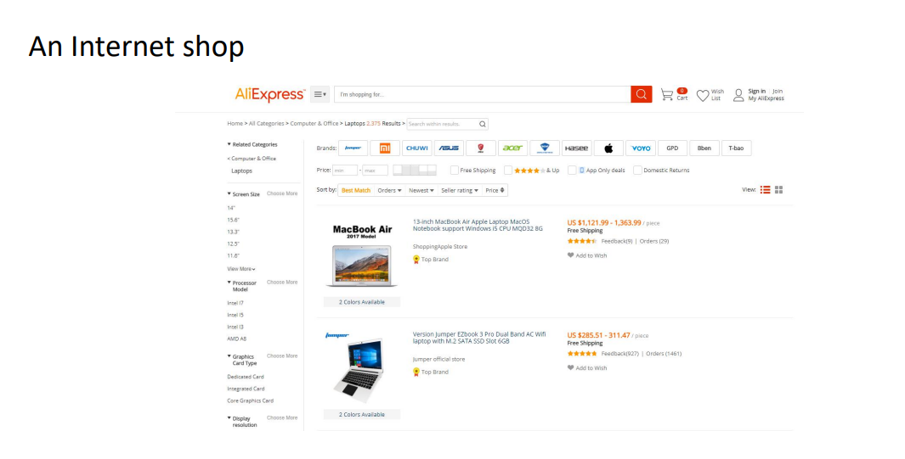
Type of Application

Slide 12
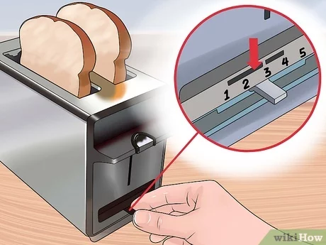
Increasing imagination for SQA
Topic
Calculator Paradox
Toaster machine and edge case discussion
Login scenario with username and password

Slide 13
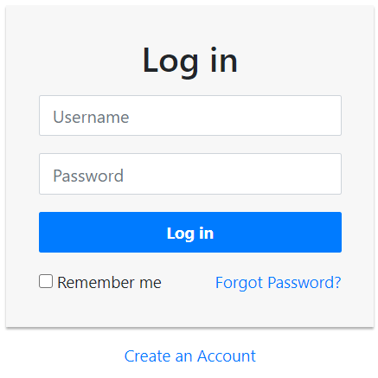
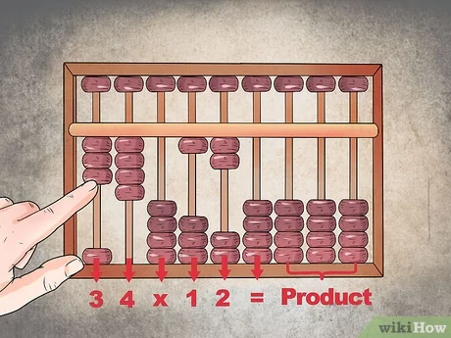

Increasing imagination for SQA
Topic
Calculator Paradox
Toaster machine and edge case discussion
Login scenario with username and password

Slide 14
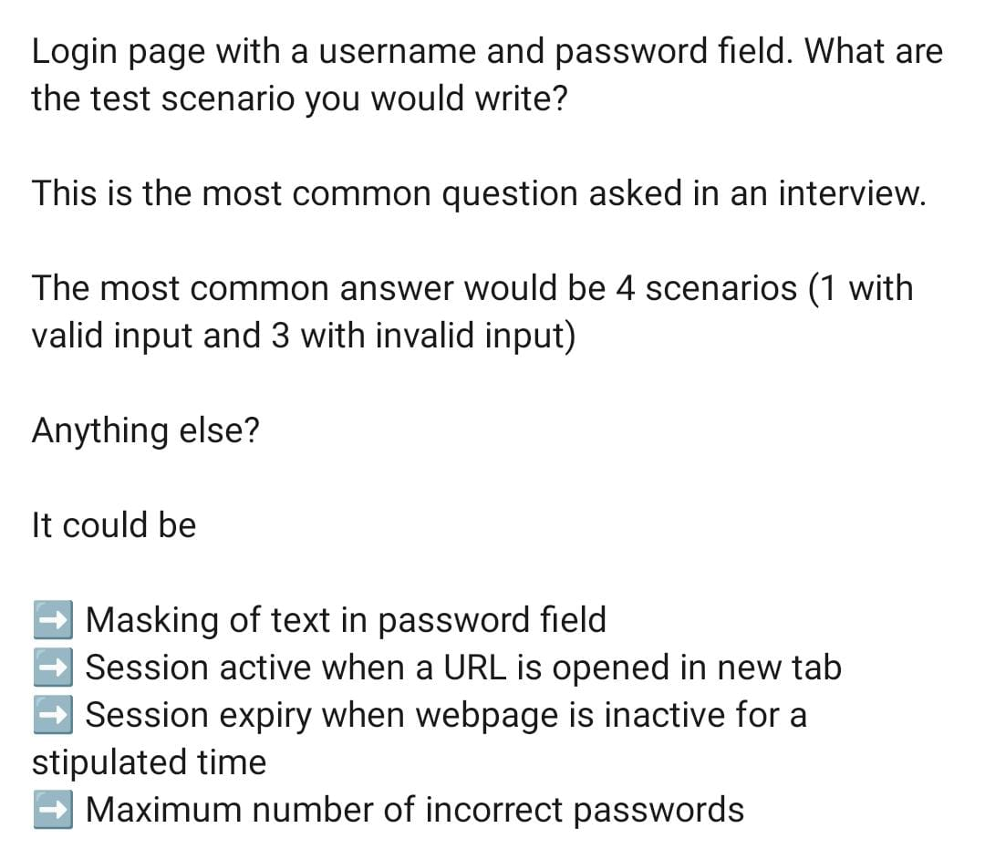
Login scenario with username and password
Login scenario with username and password

Slide 15
Manual Software Testing
Today’s Topic
Test case
Summary Report
Bug Reporting
Test Matrics
MindMaps
UI testing checklist
SDLC model
Requirements
Designing
Development
Testing
Deployment
Maintenance

Slide 16
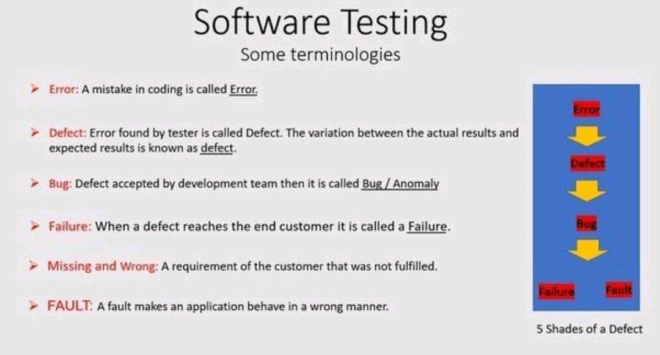
Error Defect Failure

Slide 17
Increasing imagination for SQA
Topic
Calculator Paradox
Toaster machine and edge case discussion
Login scenario with username and password

Slide 18
Increasing imagination for SQA
Topic
Calculator Paradox
Toaster machine and edge case discussion
Login scenario with username and password

Slide 19
Login scenario with username and password
Login scenario with username and password

Slide 20
Test Case
What is test case?
Why Test case?
How to write test case?
Columns of test case
Summary Report of test case
Example of a test case
Show from my pc
https://www.softwaretestinghelp.com/login-page-test-cases/

Slide 21
Test case columns
#SL | Module | Type of Testing | Features | Test Cases | Expected Result | Actual Result | Test Data | Reproducing Steps | Bug Screen Shot | Dev Comments (Not QA) | Status
SL1 | User Management | Funtctional testing | Signup | Creating user with existing email | User should not be created with valid error message | Found as per expected with error “An account with this email already exists” | easabbir@gmail.com | Step: 1 Go to Step: 2 |  |  | Failed
 |  | Compatibility tet | Signin | Chrome | Should be able to

Slide 22
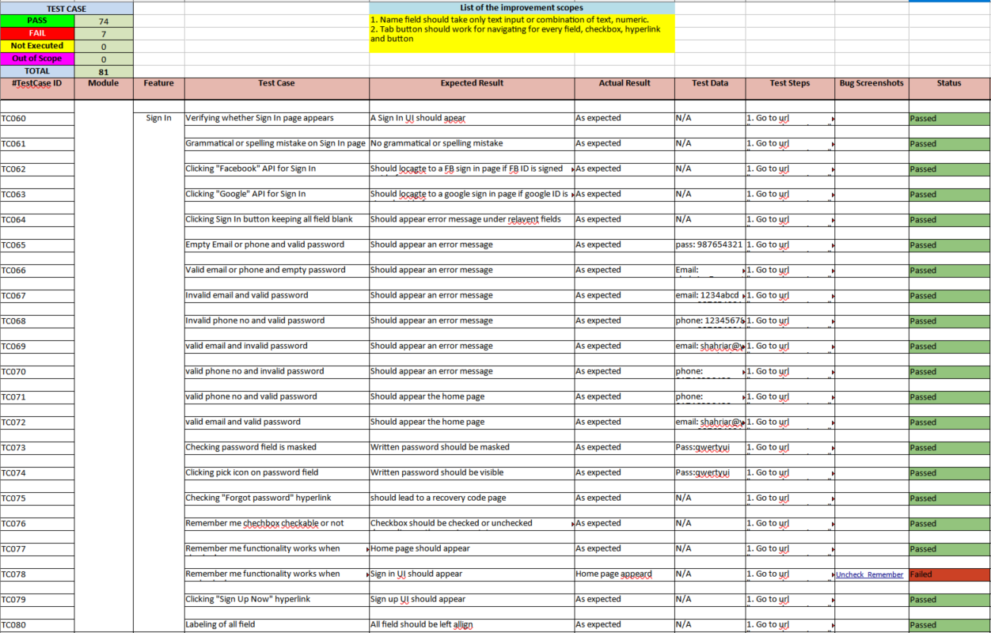
Test case Example

Slide 23
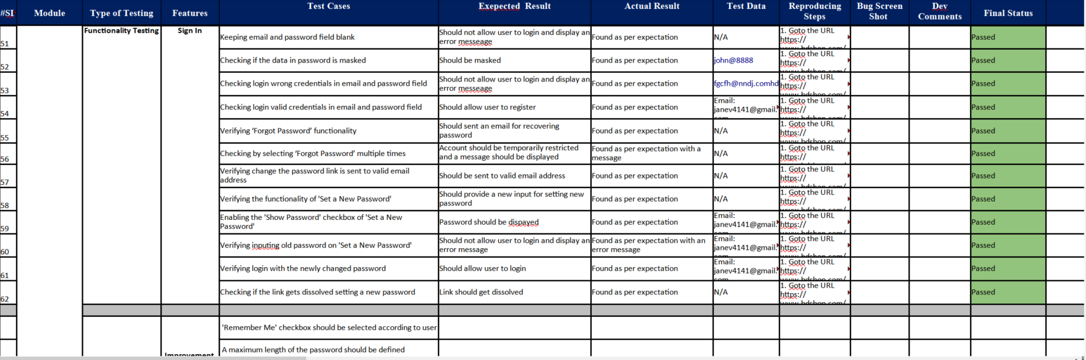
Test case Example

Slide 24
Bug Reporting
Contents of single bug report
What Are The Key Elements In A Bug Report?
Ans# An ideal bug report should contain the following key points.
- A unique ID.
- Defect description – a short description of the bug.
- Expected-
- Actual behavior-
- Steps to reproduce – test steps to emulate the issue. We should also provide the test data.
- Environment – add any system settings that could help in reproducing the issue.
- Module/section of the application in which issue has occurred.
- Severity:
- Screenshots:
- Responsible QA – point of contact in case you want to follow-up regarding this issue.

Slide 25
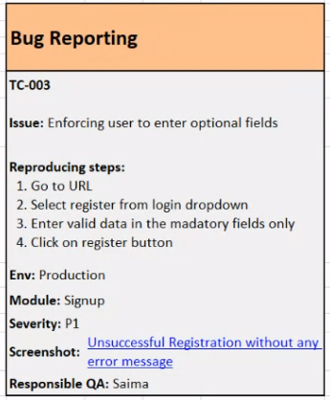
Bug Reporting example
Example of a bug report
TC-001
Issue: Unable to create new user
Expected:
Actual:
Reproducing steps:
Go to signup
Create new user
Env: CI
Module: signup
Severity: P1
Screenshot:
Responsible QA: shakil

Slide 26
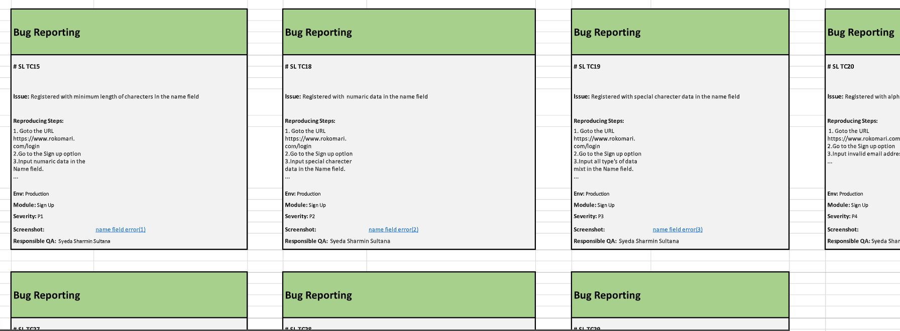
Bug Reporting example
Example of a bug report in excel sheet if there are multiple bug report

Slide 27
Whats Next?
Create your own test case
Read about mindMaps
UI testing checklist.
Issue sample
Ask questions

Slide 28
Manual Software Testing
Today’s Topic
Test Case idea generation (Transfer Money)
Four Principles of QA Life
Test Metrics
Mind Maps
50 Questions set

Slide 29
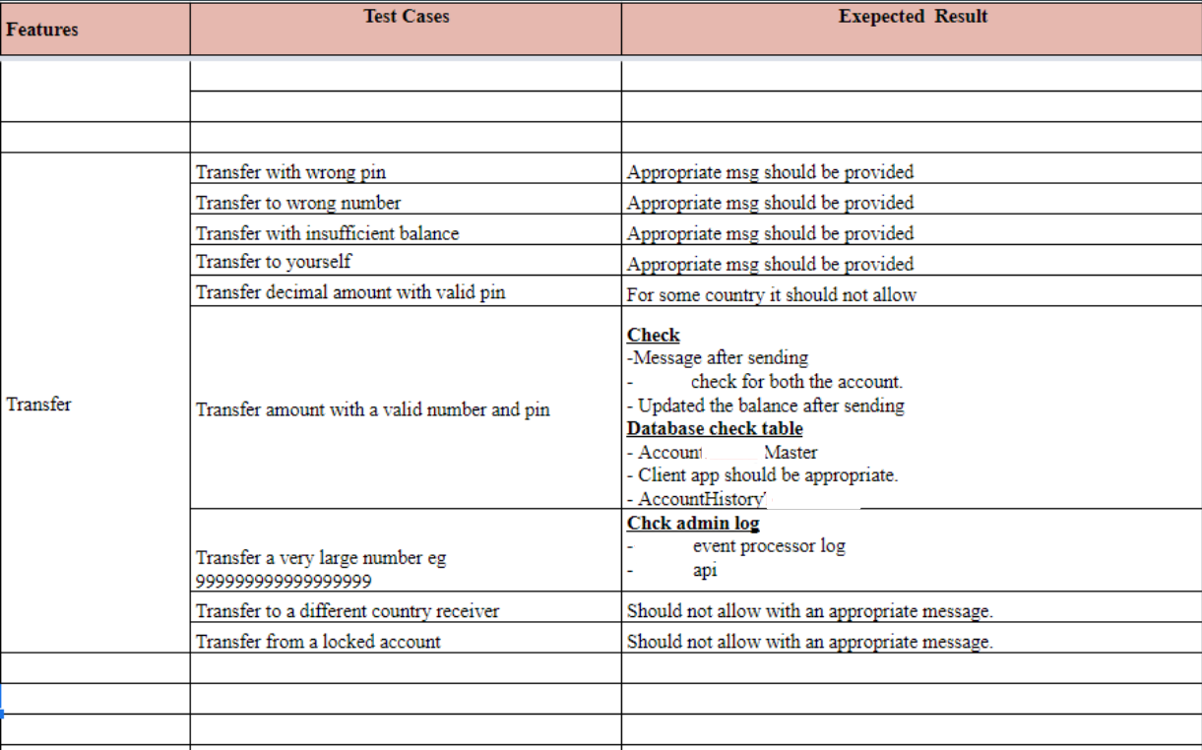
Manual Software Testing
Test Case idea generation (Transfer Money)

Slide 30
Manual Software Testing
Four Principles of QA Life
Murphy's law:
The more you fear something the more it will happen.
Anything that can go wrong, will go wrong.
Kidlin's law:
If you can write down the problem clearly, then the matter is half solved.
Gilbert's law:
The biggest problem at work is that, no one tells you what to do.
Falkland's law:
When you don't have to make a decision, then don't make a decision.

Slide 31
Manual Software Testing
Today’s Topic
Test Case idea generation (Transfer Money)
Four Principles of QA Life
Test Metrics
Mind Maps

Slide 32
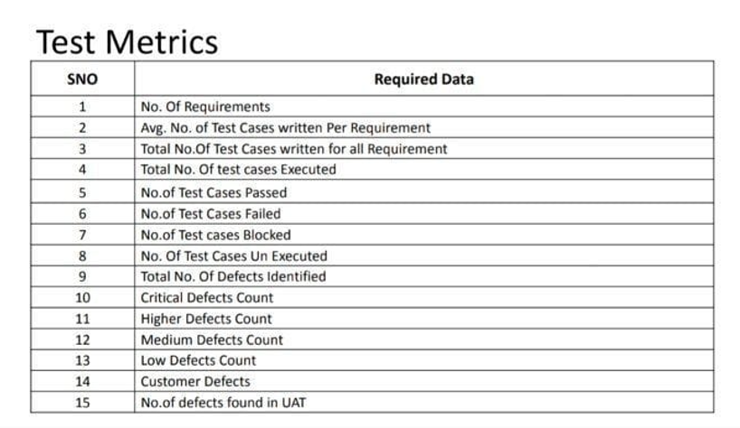
Test Metrics
Need the number of the following to calculate the metrics

Slide 33
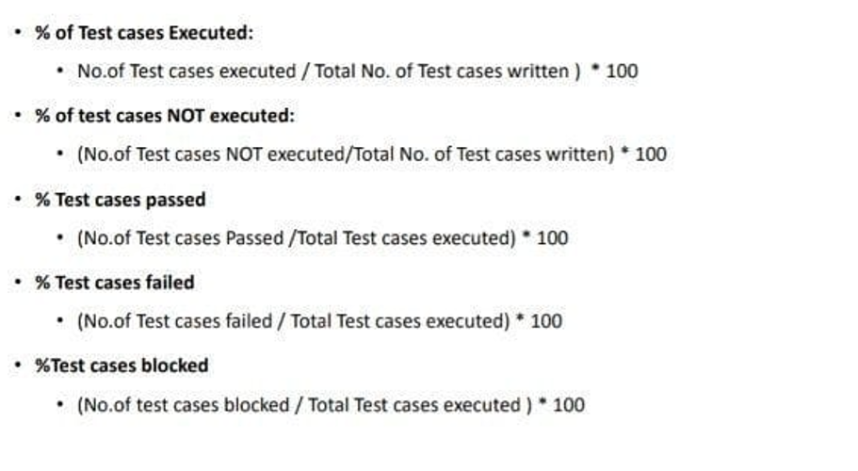
Test Metrics
Apply the formula to calculate the following

Slide 34
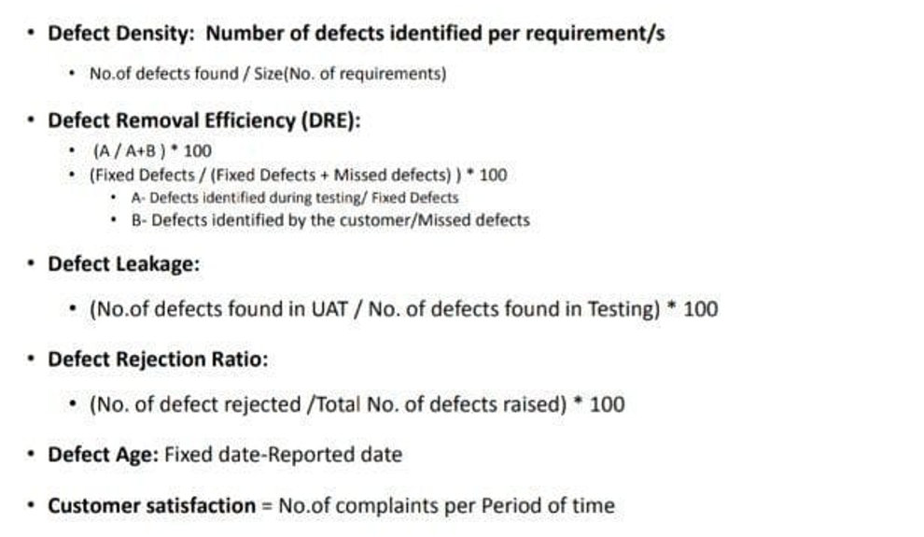
Test Metrics
Apply the formula to calculate the following

Slide 35
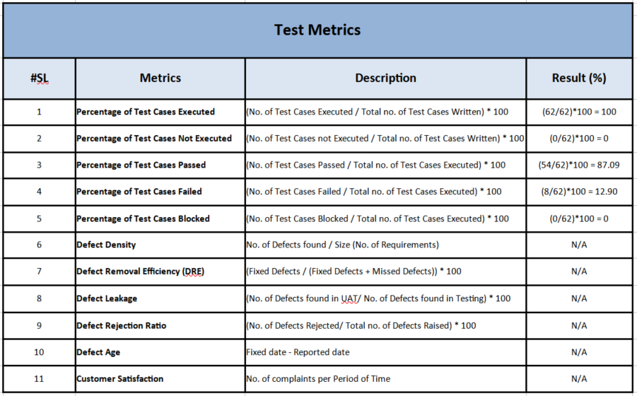
Test Metrics example

Slide 36
MindMaps
Free tools to download: xmind
https://xmind.app/download/
Youtube contents to watch for 11min
https://youtu.be/-m2wRkxCQaw
Demo in class: using xmind

Slide 37
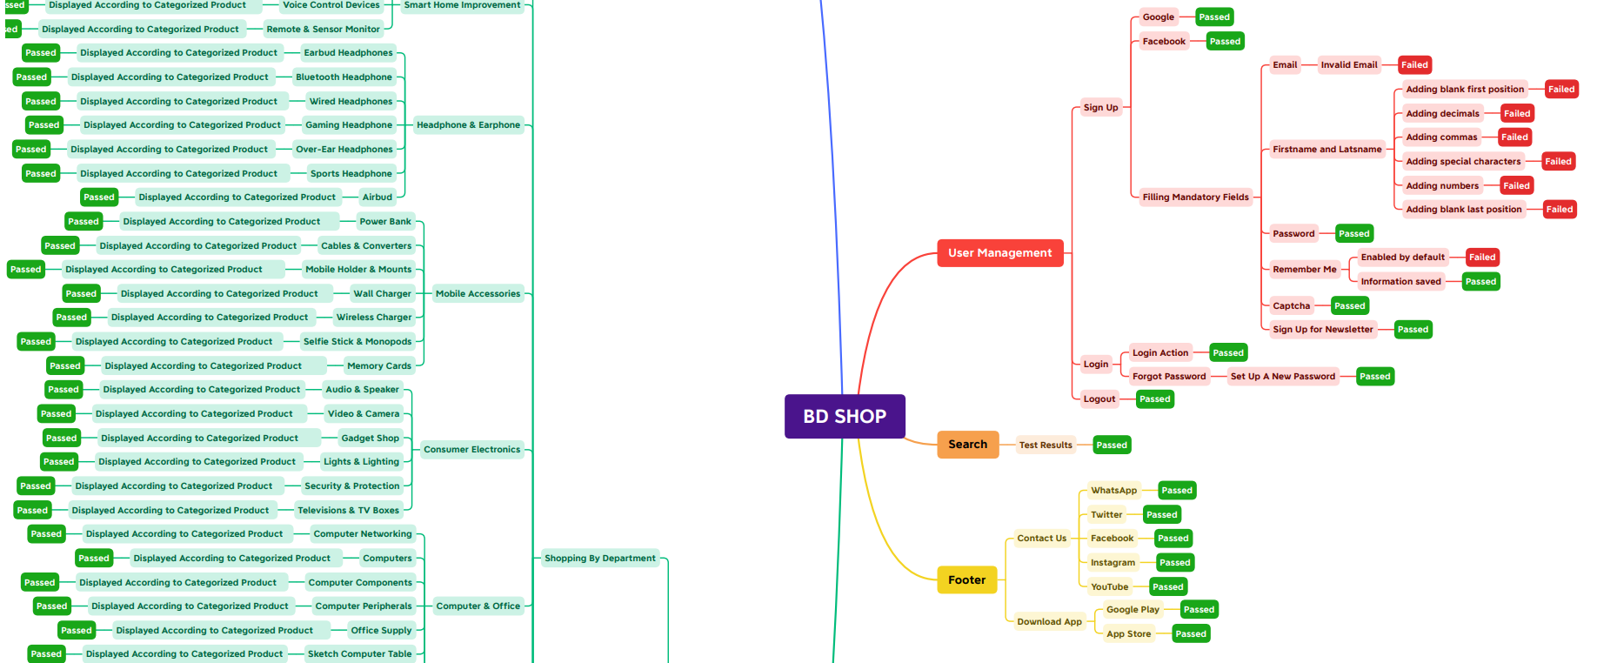
MindMaps Example

Slide 38
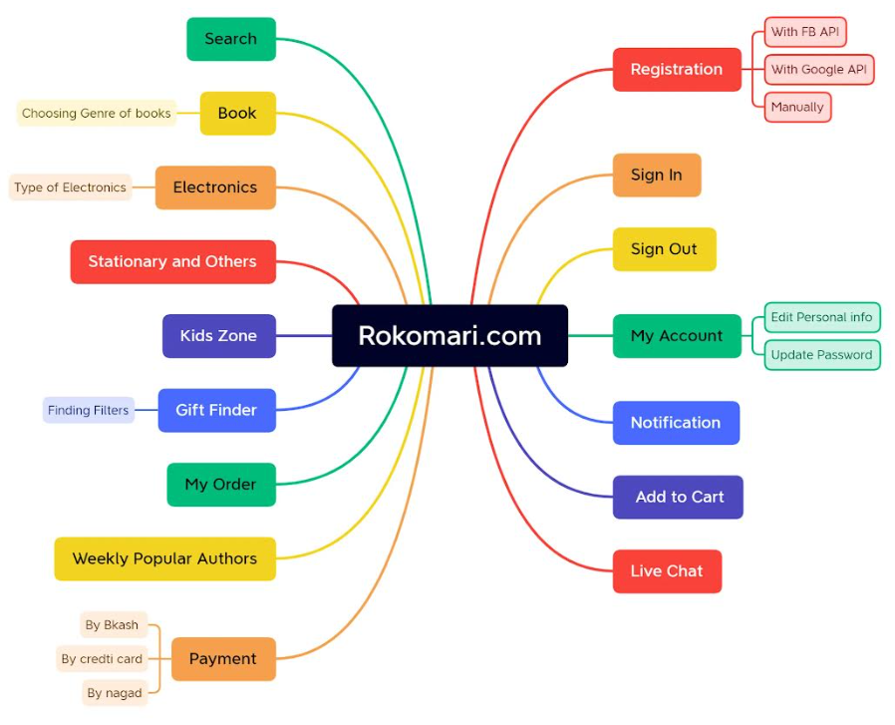
MindMaps Example

Slide 39
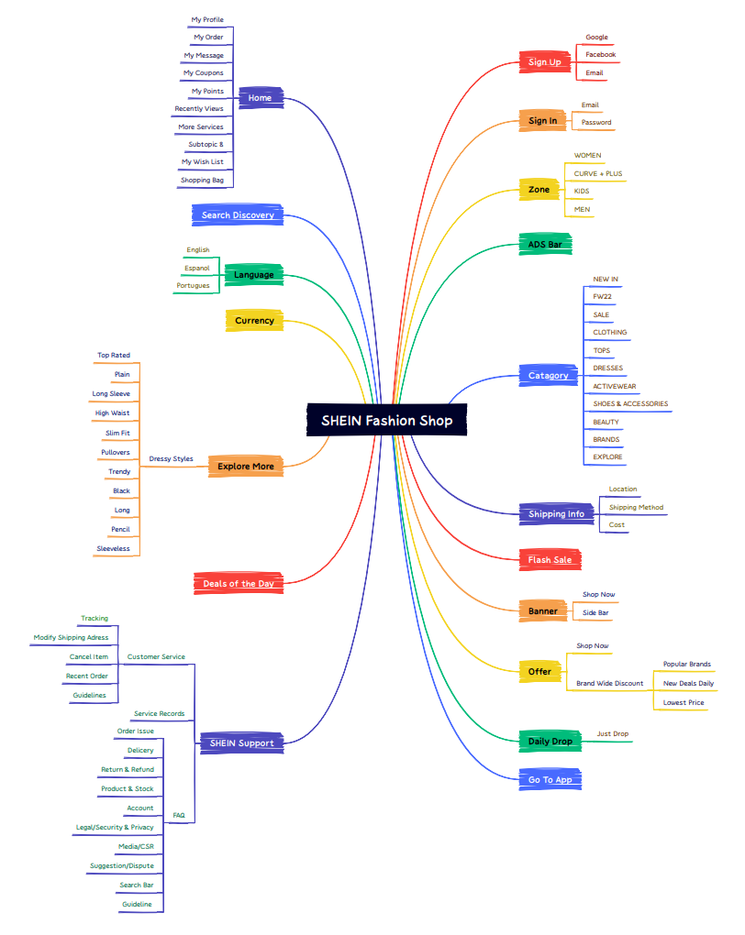
MindMaps Example

Slide 40
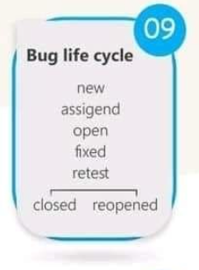
Software Test Life Cycle And Bug Life Cycle
Software Test Life Cycle
i) Requirement Analysis
ii) Test Planning
iii) Test Design & Development
iv) Test Environment Setup
v) Test Execution
vi) Test Cycle Closure

Slide 41
Test Plan Template
1) Test Plan ID: | Some type of unique company generated number to identify this test plan.
2) Introduction: | Describe the purpose of the Plan, possibly identifying the level of the plan (System Test Plan etc.). This is essentially the executive summary part of the plan.
3) Test Items: | These are things you intend to test within the scope of this test plan.
4) References: | List all documents that support this test plan. Refer to the actual version/release number of the document as stored in the configuration management system.
5) Features to be Tested: | This is a listing of what is to be tested from the Users viewpoint of what the system does. This is not a technical description of the software, but a User’s view of the functions.
6) Features not to be Tested: | This is a listing of what is NOT to be tested from both the Users viewpoint of what the system does and a configuration management/version control view. This is not a technical description of the software, but a User’s view of the functions.
7) Test Approach: | This is your overall test strategy for this test plan; it should be appropriate to the level of the plan (master, acceptance, etc.) and should be in agreement with all higher and lower levels of plans. Overall rules and processes should be identified.
8) Entry Criteria: | It describes when to start Testing
9) Exit Criteria: | It describes when to stop testing
10) Suspension Criteria: | It describes when to stop testing temporarily.

Slide 42
Test Plan Template
11) Roles & Responsibilities | Team Lead or Test Lead and Team members Roles and Responsibilities.
12) Schedule: | Schedule for all Test activities in this Software Test Process.
13) Training: | > Training on the application/system (Domain Training) > Training for any test tools to be used.
14) Test Environment / Lab: | It describes Require Hardware and software for setting-up Test Environment or Test Lab.
15) Test Deliverables: | Lists out that what is to be delivered as part of this plan
16) Approvals | Who can approve the process as complete and allow the project to proceed to the next level.
17) Glossary: | Define terms and acronyms used in the document, it can be used to understood the terms used in this plan.
 | For test strategy : https://www.nearform.com/blog/how-to-write-software-test-strategy-document/

Slide 43
Test Plan Sample
1) Test Plan ID: | ITBD_APP_TP_001
2) Introduction: | It is System Test Plan for Interment Banking System, internet web application, provides access to Account holders and guest users from any ware in the world. It has two interfaces one is Admin interface another is User interface. Admin can be accesses by Bank authorized users, user interface can be accessed by Bank account holders and guest users. The propose of the system (Application) is to provide bank information and services online (through Internet), Bank account holders can get Banking services from any ware, without visiting the Bank branches.
3) Test Items: | Admin Interface: Master Data , User Management , Reports etc… User Interface: Information, Personal Banking, Corporate Banking Business Etc…
4) References: | Requirements, Project Plan , Test Strategy — Use cases (If available) High Level Design doc , Low Level design docs, Process guide line doc, Prototypes
5) Features to be Tested: | a) Admin Interface: i) Master Data 1) Add new branch, Edit Branch /Delete Branch 2) Add new ATM 3) Add new loan type 4) Add new account type 5) Add new deposit type …. ii) User Management 1) Create new user 2) Edit user 3) Delete user etc….. iii) Reports 1) Branch wise report 2) User wise report 3) Day, month, yearly reports 4) Service wise report (only loans, only new account. fixed deposits b) User Interface: i) Information 1) Branch locators 2) ATM locators 3) Loans information 4) Bank history 5) Bank financial details 6) Fixed deposits information 7) Calculators etc… ii) Personal Banking 1) Login 2) Balance enquiry 3) Bill payment (utilities, subscriptions) 4) Fund transfer (transfer to same bank, others banks) 5) Statement generation (mini statement, detailed report) etc… iii) Corporate Banking 1) Add user, Edit user, Delete user 2) Balance enquiry 3) Money transfer 4) Payroll 5) Reports etc..

Slide 44
Test Plan Sample
6) Features not to be tested: | NA
7) Entry Criteria: | a) Test Design Team formation, Responsibilities, Schedule, Requirements, Test Case Template etc… Training on Domain, on Automation tools b) Test Execution: Readiness of Test Lab Readiness of AUT Requirements Test Case docs Test Data Defect Report Template Etc…
8) Exit Criteria: | All possible test cases executed Maximum defects fixed, Final Regression performed successfully, Confidence on Test process, Time Limitations, Budget Limitations
9) Suspension Criteria: | Show-Stopper bug found, Supplier issues, Vast changes in requirements, If resolving defects are more time consuming/expensive
10) Roles & Responsibilities | Sno Name Role Responsibilities Remarks 1 Ehsanul Alam Sabbir Test Lead Test Planning, guidance, Monitoring and Test control 2 some name, Tester, Test Data Collection, Generating Test Scenarios. 3 some name, Tester, Test Case Documentation, Test execution, defect reporting and tracking for Admin module. 4 some name, Tester, Test Case Documentation, Test execution, defect reporting and tracking for Personal Banking module. 5 some name, Tester, Test Case Documentation, Test execution, defect reporting and tracking for Corporate Banking module

Slide 45
Test Plan Sample
11) Schedule: | Task Days Duration Remarks 1) Understanding & Analyzing Requirements. 2nd July to 6th July Review Meeting 9th July Generating Test Scenarios. 11th July to 22nd July Reviews 25th July to 26th July 5) Test Case Documentation 29th July to 12th August Reviews 14th August to 18th August 7) Test Data collection 06 20th August to 26th August 8) Reviews 01 28th August 9) Verifying Test Environment setup 01 29th August 10) Create Test batches 02 30th, 31st August 11) Sanity Testing 01 3rd September 12) Comprehensive Testing 25 4th September to 2nd October 13) Sanity Testing 01 3rd October 14) Selecting Test cases 02 4th and 5th October 15) Regression Testing 05 8th October to12 th October 16) Sanity Testing 01 15th October 17) Selecting Test cases 01 16th October 18) Regression Testing Cycle 2 04 17th October to 22nd October . . . . . . . . . . . . 28) Final Regression 08 19th November to 28th November 29) Evaluating exit criteria 01 or 02 29th, 30th of November 30) Collecting all artifacts 02 3rd, 4th December 31) Test Summary Report 01 5th December Note: Regression Testing depends on Application and strength of Development team.
12) Training | Training Program on Banking Domain Test Automation Training using Selenium Tool
13) Risks & Mitigation | Team member’s issues Vendor issues Time Budget
14) Test Environment / Lab | Application Type: Web Application, Internet and Public Server side: Windows Server 2016 UNIX server Ms Exchange Server a) Web Server, b) EDP, 3) Data storage Bugzilla Tool VSS MS Office Selenium Tool etc…. Browser MS Edge Client side: Windows 10 VSS MS Office Selenium Etc… AUT Environment .NET (C#, VC++, ADO) IIS -web server COM+ -App server SQL Server 2017 for Database server
15) Test Deliverables | Test Plan, Review Reports, RTM Test Scenario docs Test Case docs Test data Opened, Closed Defect Reports Test Summary Report

Slide 46
Test Plan Sample
16) Approvals | Task/s Author /Role Date & Signature 1) Test Plan Documentation Ehsan (Test Lead) 2) Review SomeName (QA Analist) 3) Approval SomeName (Project Manager)
17) Glossary | AUT -Application Under Test . . . PIN -Project Initiation Note . . . SRS- Software Requirements Specification . . .

Slide 47
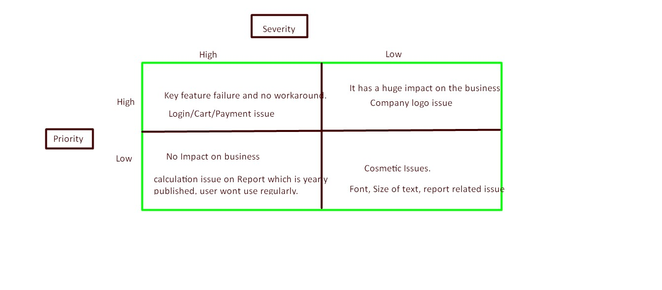
Priority and severity discussion

Slide 48
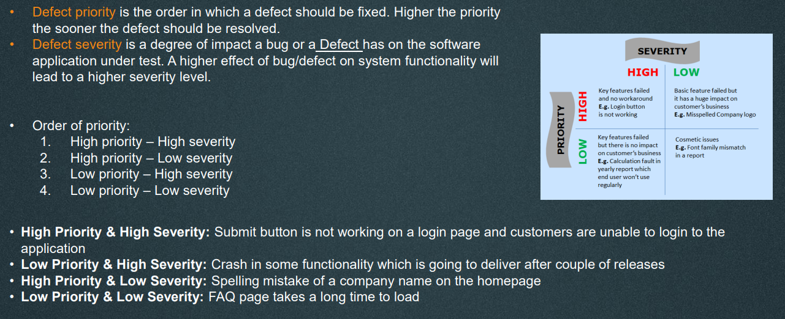
Priority and severity discussion

Slide 49
Discuss on website testing
Functional Testing | Features and operational behaviour check and Ensure they are responding correctly to its specification. -Test all the links -Internal link -external link -anchor links -mailTo links -form check -default values -test cookies -form data gets written database. -Internal function
Functional Test scenario | - mandatory field, asterisk, and hints for the mandatory field - optional field not showing error message - remember me -leap years validated -Test the numeric filed so that alphabets are not accepted and proper error message. -test for negative number, decimal, special character, alphanumeric -test for division by zero exception should be handled properly. -max length/min length check -pop up message check -same user name -confirmation message for update or delete operation. -amount value with currency -timeout functionality -sorting functionality -functionality of buttons -privacy policy and FAQ and language should be clearly defined and available for users. - functionality failure should redirect user to custom error message.

Slide 50
Discuss on website testing
Usability testing | Ease of use and effectiveness of a product to meet standard usability practice.
Interface Testing | Application Web server Database Server
Database Testing
Compatibility Testing | Browser check(IE, Firefox, Chrome, Safari, Opera, Edge, Onion) Image, Fonts properly displayed in different browsers. Javascripts executing properly in different browsers. Animated GIF’s should show in different browsers.
Performance Testing | Under different load condition, application properly behaving. Peak users level Response time
Security Testing | HTTPS protocol Encrypted format data for important data eg password, credit card Password rules for new user Old password not reusable Error message should not show important data User session management View source code switched off Brute force SQL inection

Slide 51
Discuss scenario based question for manual tests
Login | Signup
Limit total no. of unsuccessful attempts
Session, inactive , forcefully logout
Auto login for remember me button
Responsiveness
Security related test case
Cookies , user consent

Slide 52
Manual Testing
1) Software Development Life Cycle and SDLC Model | i) Requirement Gathering ii) Analysis iii) Design iv) Coding / Development v) Testing vi) Deployment & Maintenance SDLC Models i) Waterfall Model ii) V Model
2) Software Test Levels | i) Unit Testing ii) Integration Testing iii) System Testing iv) Acceptance Testing
3) Software Test Types | i) Functional testing ii) Non-functional testing iii) Structural testing iv) Change related testing
4) Software Test Design Techniques | i) Static Test Design Techniques ii) Dynamic Test Design Techniques

Slide 53
4) Software Test Design Techniques
i) Static Test Design Techniques | a) Reviews (Manual Examination) 1) Informal Review 2) Walk through 3) Technical Review 4) Inspection b) Static Analysis (Automated Analysis)
ii) Dynamic Test Design Techniques | a) Specification based or Black box Techniques 1) Equivalence Partitioning (EP) 2) Boundary Value Analysis (BVA) 3) Decision Table Testing 4) State Transition Testing 5) Use Case Testing Etc… b) Structure based or White box Techniques 1) Statement Coverage 2) Decision Coverage 3) Condition Coverage 4) Multi Condition Coverage 5) LCSAJ etc… c) Experience based Techniques 1) Error Guessing 2) Exploratory Testing Etc…

Slide 54
4) Software Test Design Techniques
1) Equivalence Partitioning (EP) | In Equivalence Partitioning, inputs to the Software are divided into groups that are expected to exhibit similar behavior.
2) Boundary Value Analysis (BVA) | Behavior at edge of each equivalence partition is more likely to be incorrect than behavior within the partition.
3) Decision Table Testing | The decision tables are good way to capture system requirements that contain logical conditions.
4) State Transition Testing | In State transition Testing Test cases are designed to execute valid and invalid state transitions.
5) Use Case Testing Etc | In Use Case Testing Test Cases are designed to execute User Scenarios or Business Scenarios.

Slide 55
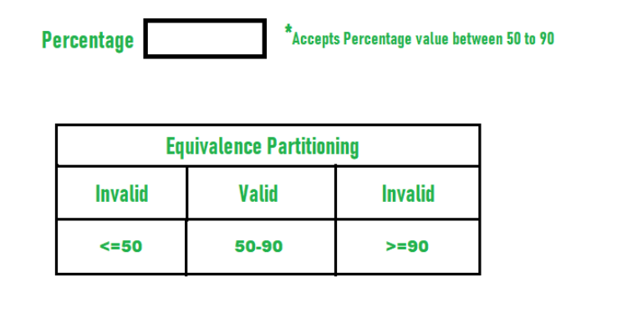
1) Equivalence Partitioning (EP)

Slide 56
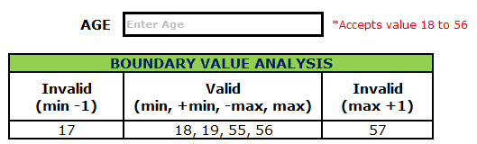
2) Boundary Value Analysis (BVA)

Slide 57
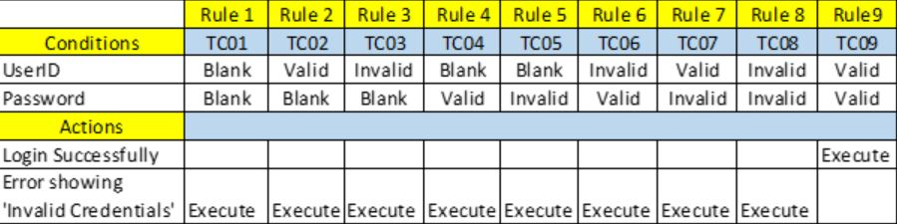
3) Decision Table Testing

Slide 58
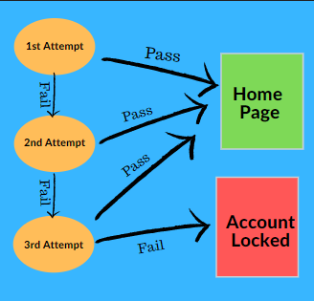
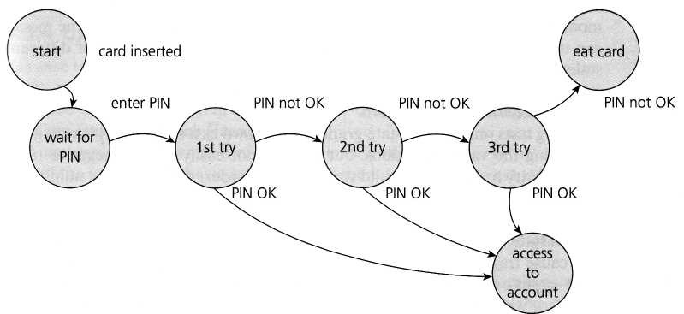
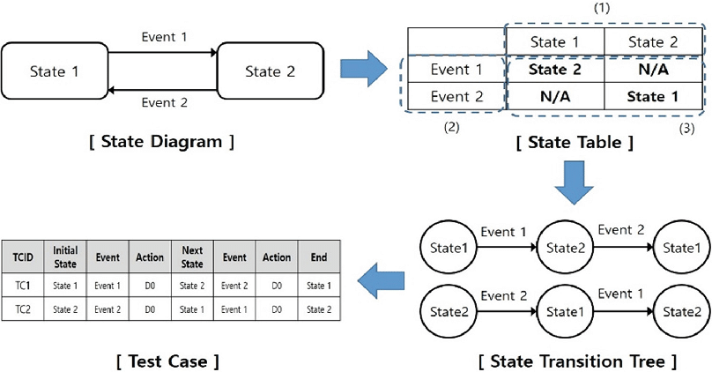
4) State Transition Testing

Slide 59
5) Use Case Testing Etc
• In Use Case Testing Test Cases are designed to execute User Scenarios or Business Scenarios.
Business Scenario:
ATM Cash Withdrawal operation Mainstream Scenario:
1) User: Inserts ATM Card System: Asks for PIN
2) User: Enters PIN System: Validates PIN and asks to select language
3) User: Selects Language System: Asks to select Account Type
4) User: Selects Account Type System: Asks to enter Amount
5) User: Enters Amount System: Releases Money
Alternatives
2a) Suppose if user enters invalid Pin System: Shows error message and asks to enter correct PIN User: Enters Correct PIN ———————–
4a) Suppose if user selects incorrect Account Type
System: Shows error and asks to select correct Account Type User: Select correct account type
5a) If User enters incorrect amount (More than the balance amount or more than the day limit) System: Shows Error message and asks to enter correct amount User: Enters correct amount

Slide 60
Some useful Concepts
Functional Testing and Non Functional Testing
Verification and Validation
Alpha and Beta testing
Tools and Test Techniques
Build and Release
Quality Assurance and Quality Control
Show Stopper
Globalization and Localization
Authorization and Authentication
Types of Authentication
Rate Limiting
Caching
OSI model and protocol used in different layers of OSI model.
Agile concepts
Root Cause Analysis
Environmental Related Information

Slide 61
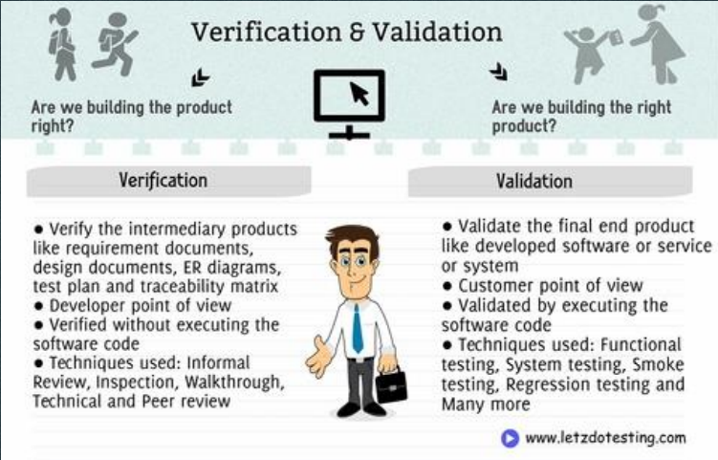
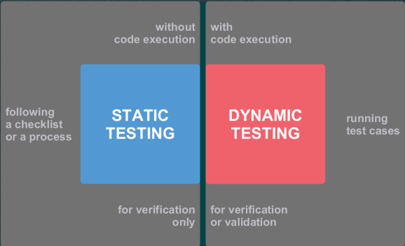
Verification and Validation

Slide 62
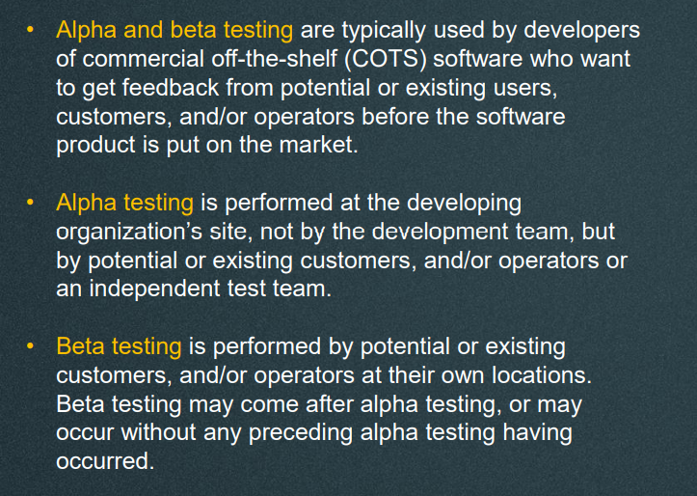
Alpha and Beta testing

Slide 63
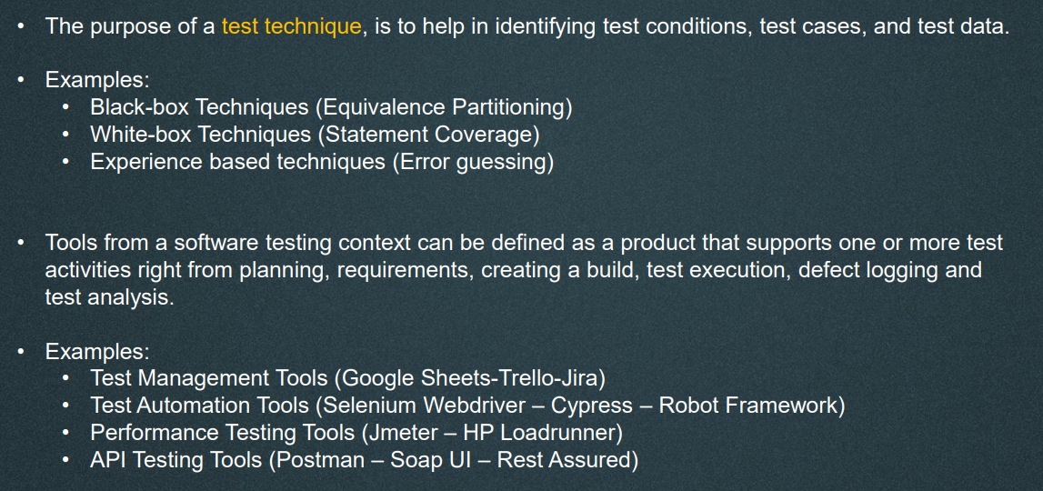
Tools and Test Techniques

Slide 64
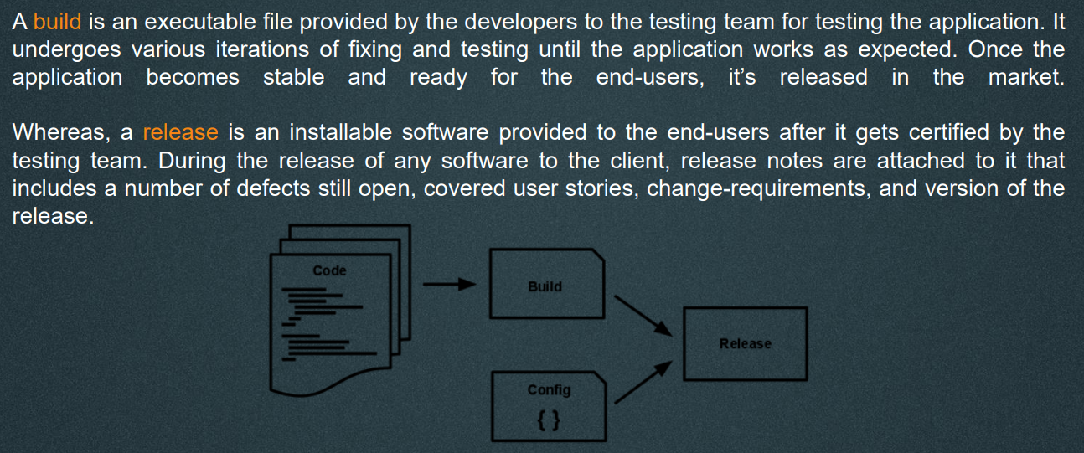
Build and Release

Slide 65
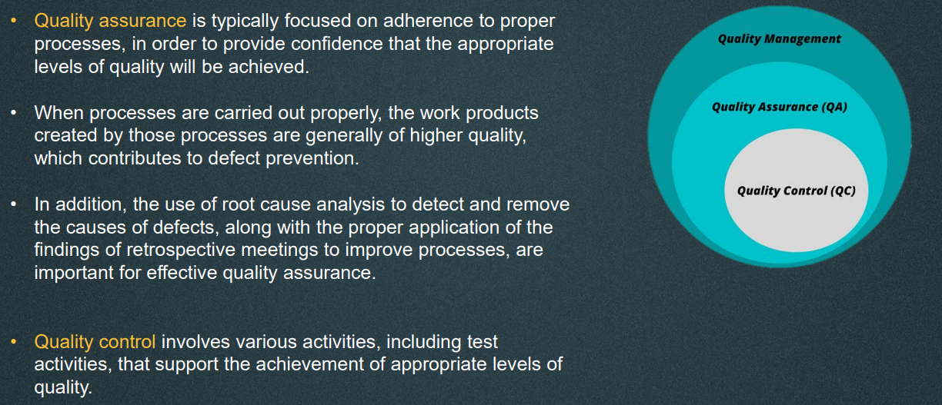
Quality Assurance and Quality Control

Slide 66
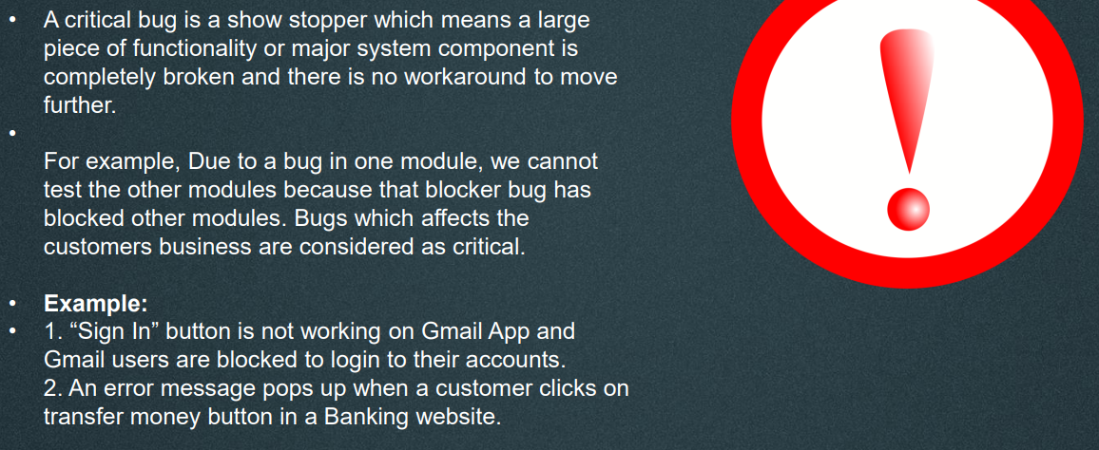
Show Stopper

Slide 67
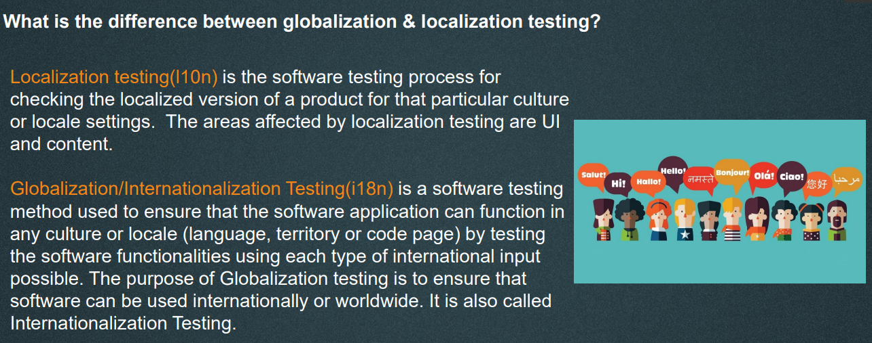
Globalization and Localization

Slide 68
Authorization and Authentication
Authentication and authorization might sound similar, but they are more related to identity and
access management (IAM).
Authentication confirms that users are who they say they are, means
Authentication confirms the identity of the user
and Authorization gives permission to those identified users to access a resource.
In simple words Authentication means “Who you are” It’s all about to proving correct identity.
And Authorization means “What you can do” It’s all about access, means do you have permission to
access something.

Slide 69
Types of Authentication
Authentication methods: There are 4 most used authentication methods below:
Basic:
HTTP Basic Authentication is rarely recommended due to its security vulnerabilities. This is
the most straightforward method and the easiest. With this method, the sender places a
username: password into the request header. The username and password are encoded with
Base64, which is an encoding technique that converts the username and password into a set of 64
characters to ensure safe transmission. This method does not require cookies, session IDs, login
pages, and other such specialty solutions, and because it uses the HTTP header itself.
Bearer :
Bearer authentication (also called token authentication) is an HTTP authentication
scheme that involves security tokens called bearer tokens. The name “Bearer authentication” can
be understood as “give access to the bearer of this token.” The bearer token allowing access to a
certain resource or URL, usually generated by the server in response to a login request. The client
must send this token in the Authorization header when making requests to protected resources.

Slide 70
Types of Authentication
Authentication methods: There are 4 most used authentication methods below:
OAuth 2.0 :
This is very popular authentication method which is being used most nowadays. We
have seen so many times while installing an application at the time of sign-up it asks to sign up
with Google account or by Facebook etc. if we choose Facebook then we just have to login our
Facebook account and approve Yes to access. And through this process directly we can login
without sign-up. So basically, it provides a token along with some information and that
information & token get stored in that 3rd party application’s database. That is OAuth 2.0
method.
Ex: Basically, what we are doing, we are delegating our authority to google then after that Google
will ask you that like “Do you want to authorized this Instagram application?” If we say ‘Yes’ then
it will give our information to Instagram. And that information will store in Instagram database.
Next time it won’t ask login details to login. And if we change our password then automatically, we
will be logged out from Instagram. Again, it will follow same process to login. It will send a token
to Instagram that will be stored in Instagram’s database. If we remove our Instagram details from
Google then it will take back all that information from Instagram.
OAuth 2.0 is designed only for authorization, for granting access to data and features
from one application to another.

Slide 71
Types of Authentication
Authentication methods: There are 4 most used authentication methods below:
OpenID Connect (OIDC) is a thin layer that sits on top of
OAuth 2.0 that adds login and profile information about the person who is logged in.
The OpenID Connect flow looks the same as OAuth.” So basically, OIDC is one step ahead to
OAuth 2.0

Slide 72
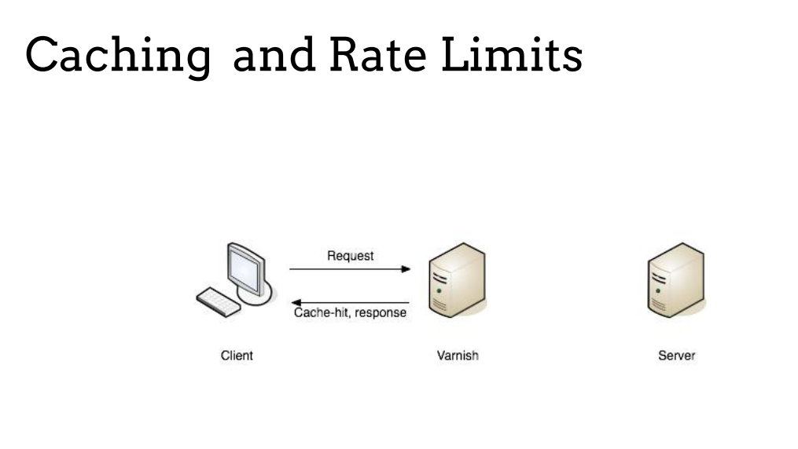
Rate Limit and Caching

Slide 73
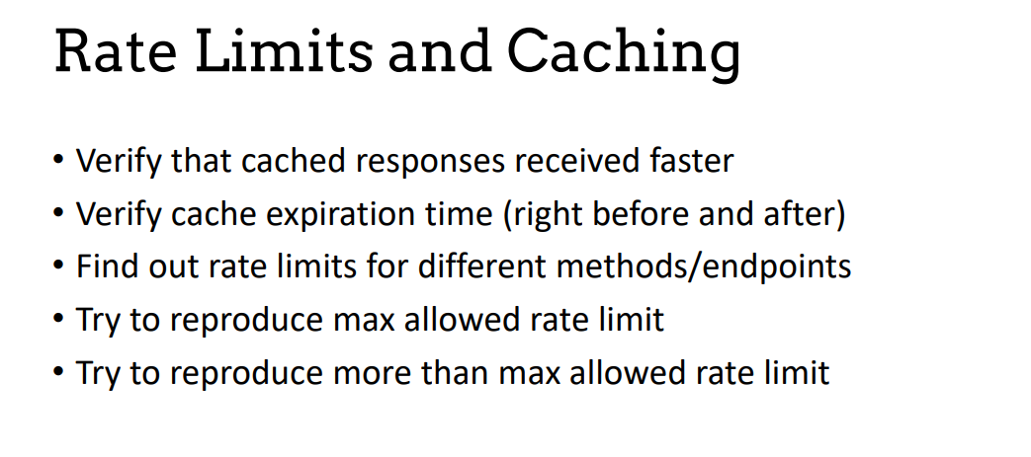
Rate Limit and Caching

Slide 74
OSI model and the protocol in each layer
https://docs.google.com/document/d/1is7uQbrfswbnihCkvd4X3riSE1m9--Z1/edit?usp=sharing&ouid=100717551578414916283&rtpof=true&sd=true

Slide 75
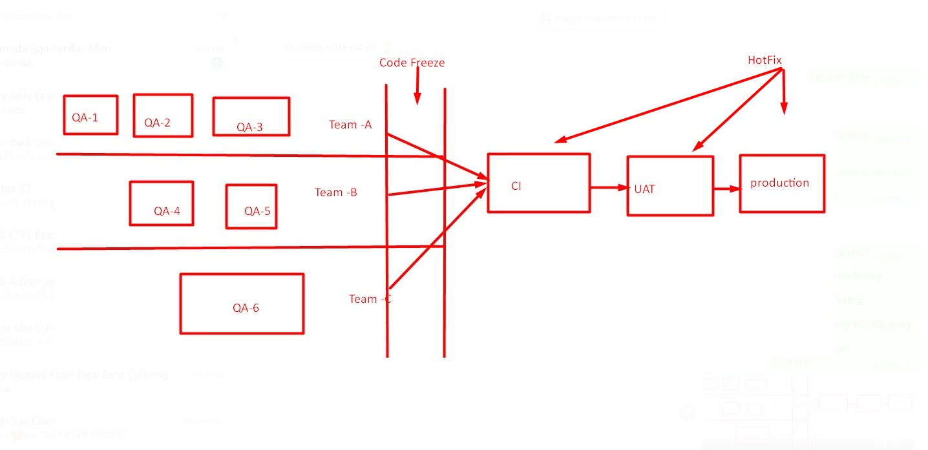
Environmental Related Information

Slide 76
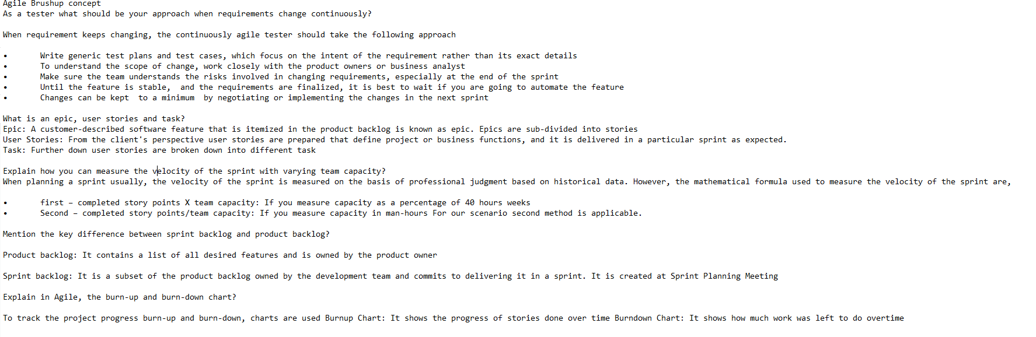
Agile Concepts

Slide 77
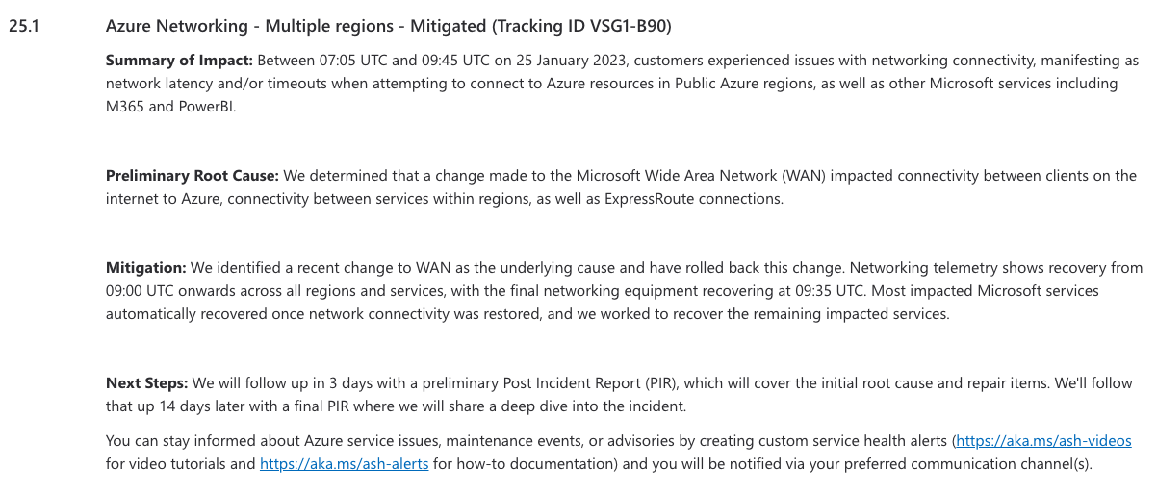


Root Cause Analysis

Slide 78

Mistakes we do

Slide 79
Whats Next?
What is coming up next?
API testing
Performance testing
GIT
Database testing and SQL query Basic JAVA
Web automation
Mobile automation
Cucumber
Cypress
Jenkins
Ask questions……………
Project Idea to add in your cv
Create test plan
Create mind maps
Create test cases
Create bug report
Create summary report
Create Test Metrics
Submit with the test case assignment whether it is asked or not. For any interview project.
Learn the document (ISTQB materials)

